Slide 1

E x e r c i s e
T r a c k i n g
S y s t e m
Group Number 5
Pankaj Nandeshwar 231110034
Pranjal Nandeshwar 231110035
Akash Varude 231110006
Deepak Patnaik 231110010
Gopichand Ankem 231110014
Pratik Patil 22111047

Slide 2
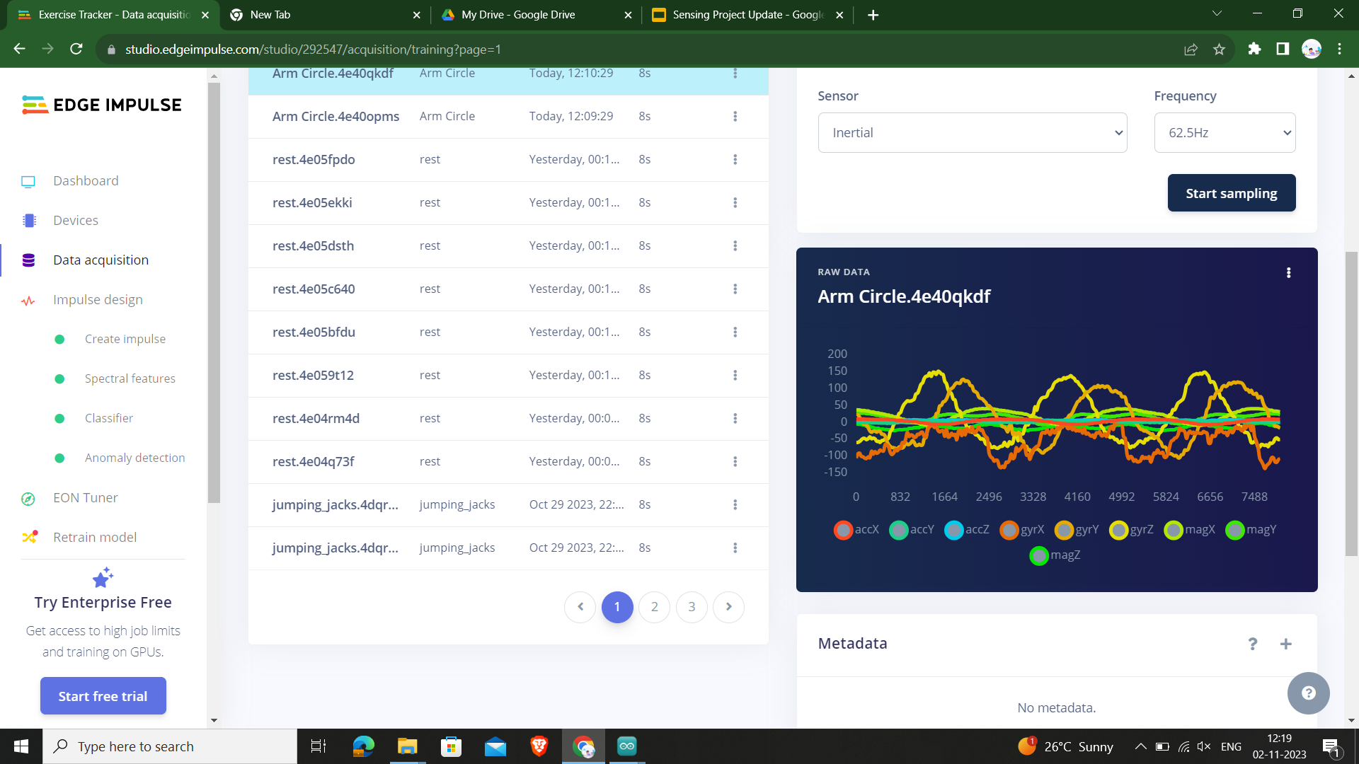
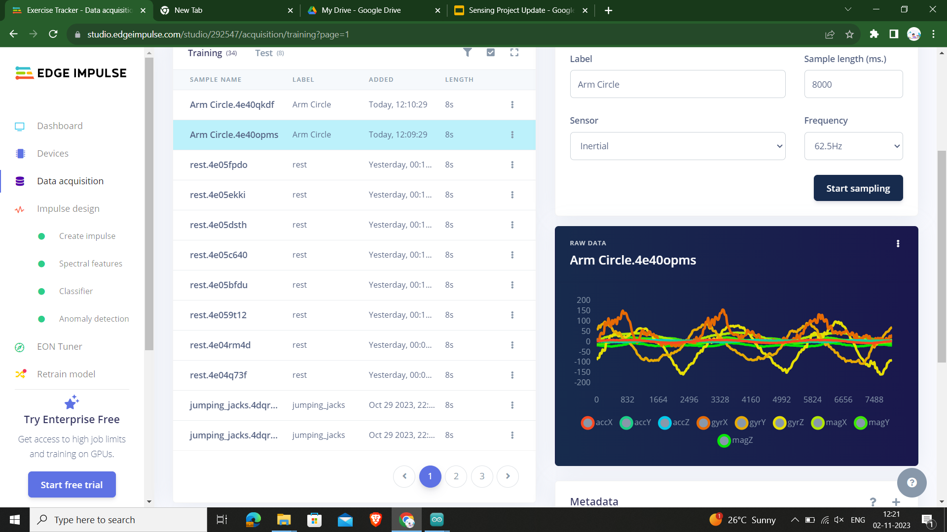
Data Acquisition
Types of Exercises used:
Pushups
Squats
Arm Circles

Slide 3
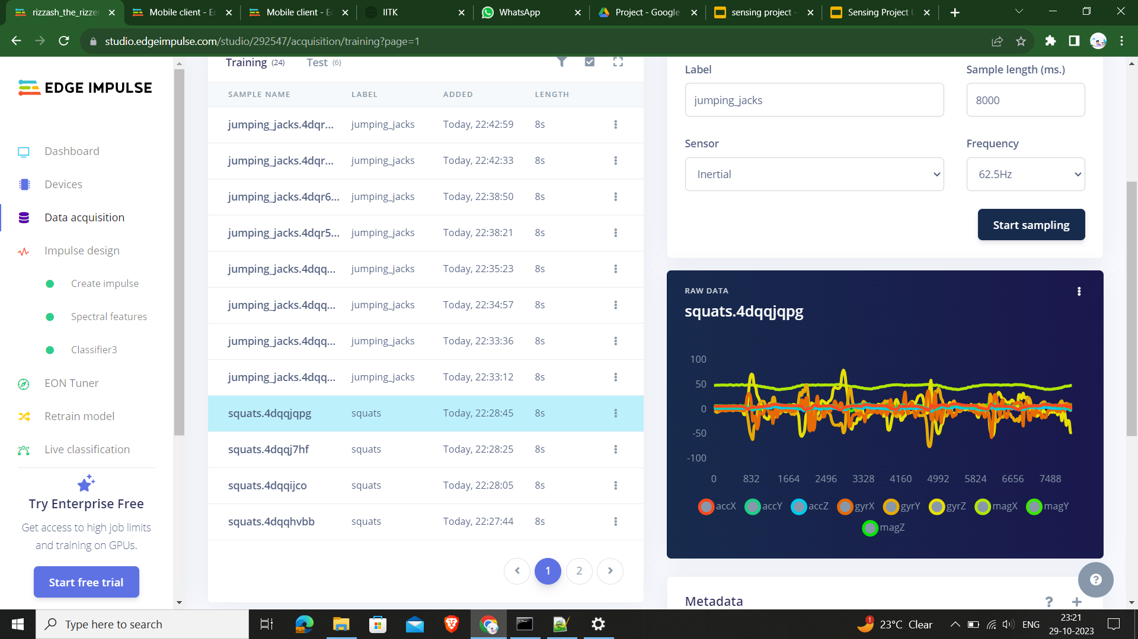
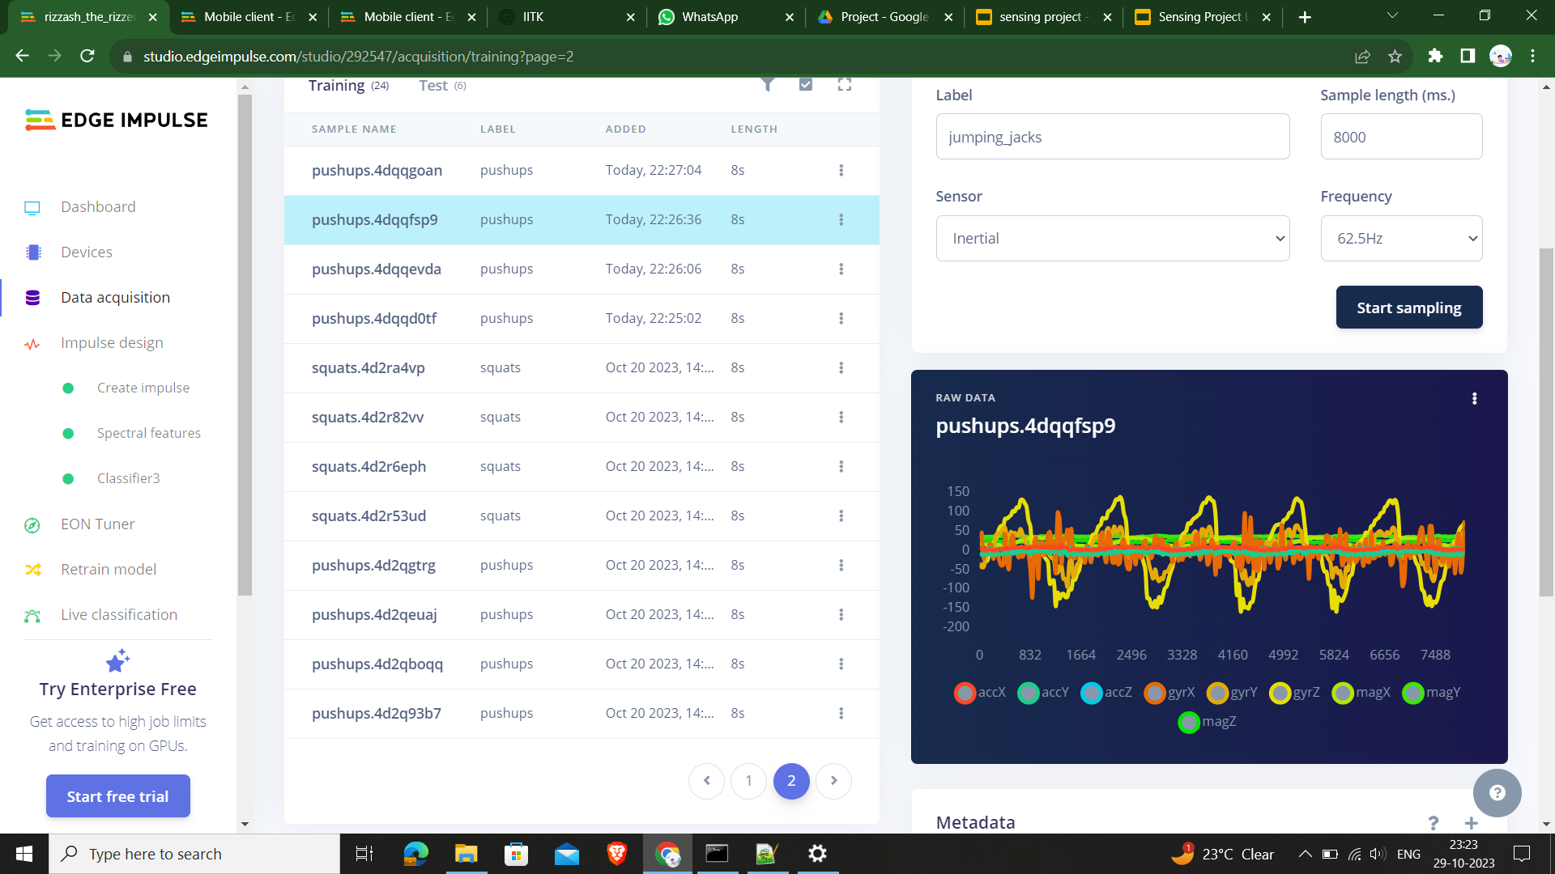

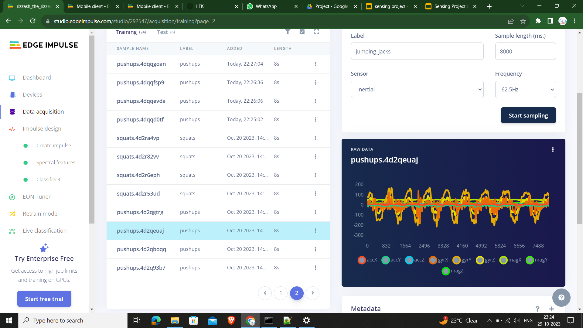
Data Acquisition

Slide 4
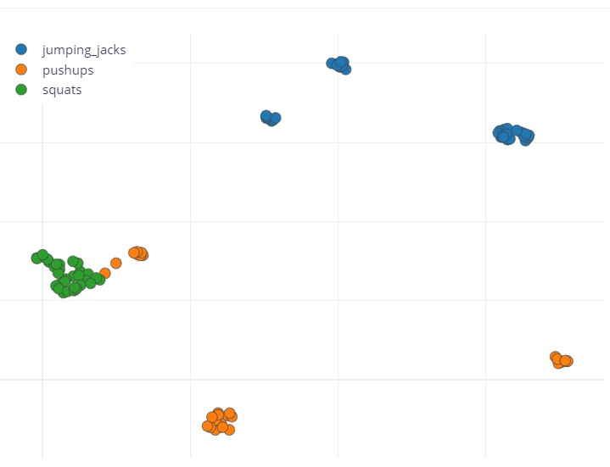
Data Visualization

Slide 5
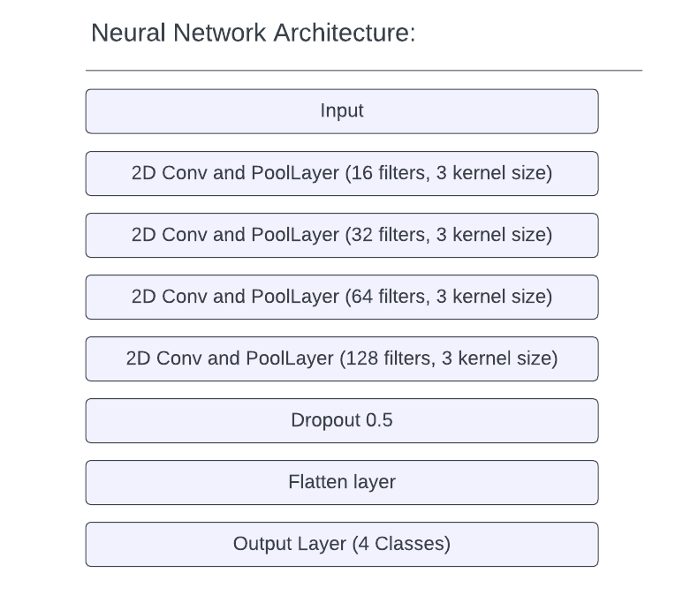
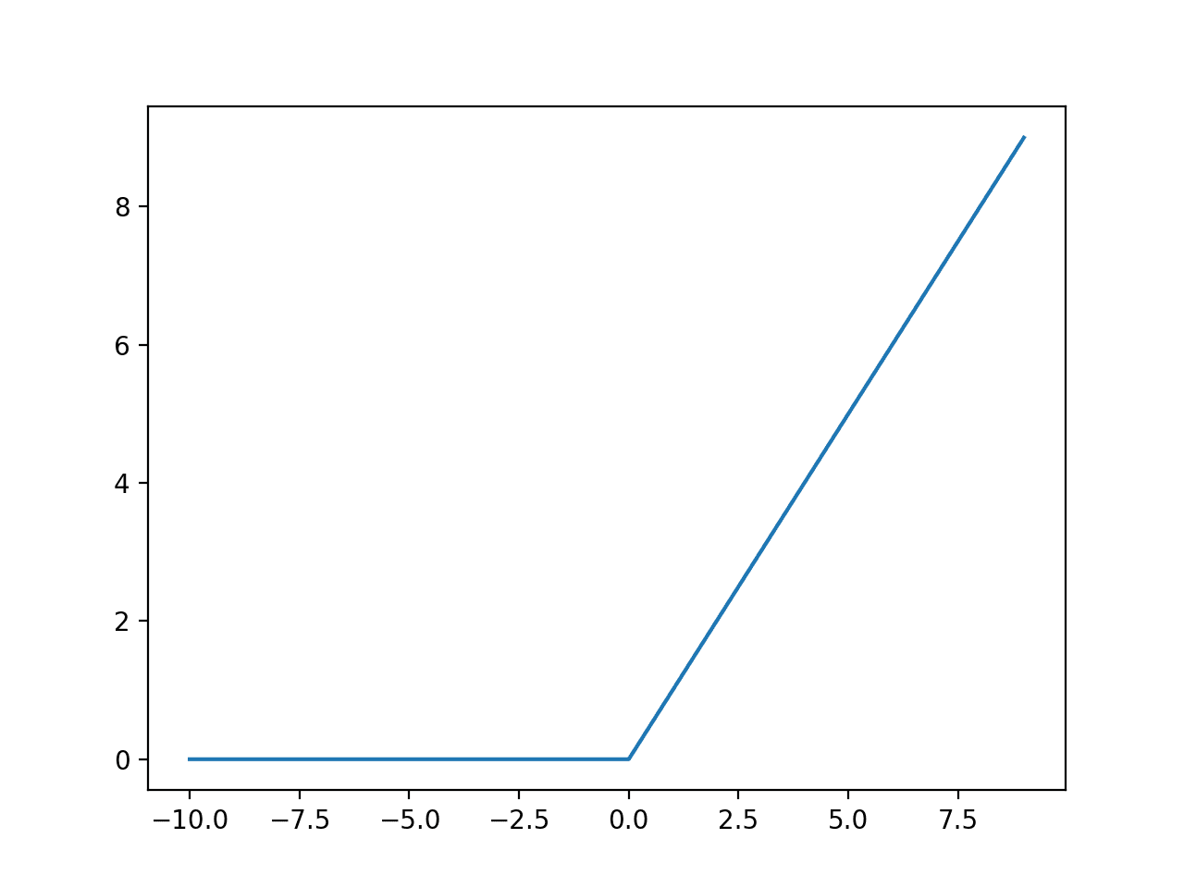
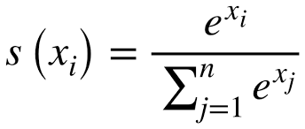
Neural Network
One Convolution Operation
Conv Layer:
Kernel of size 3 with stride of 2
Non linearity:
Relu Activation Function
Pooling Layer:
Used max pool layer
Relu Activation Function
Softmax Activation Function
f(x) = max(0,x)

Slide 6
Training Performance : 100%
 | Pushups | Squats | Arm Circles | Rest | Anomaly
Pushups | 100% | 0% | 0% | 0% | 0%
Squats | 0% | 100% | 0% | 0% | 0%
Arm Circles | 0% | 0% | 100% | 0% | 0%
Rest | 0% | 0% | 0% | 100% | 0%

Slide 7
Testing Performance : 87.50%
 | Pushups | Squats | Arm circles | Rest | Anomaly
Pushups | 100% | 0% | 0% | 0% | 0%
Squats | 25% | 50% | 0% | 0% | 25%
Arm circles | 0% | 0% | 100% | 0% | 0%
Rest | 0% | 0% | 0% | 100% | 0%

Slide 8
Model Deployment
Step-1 : Build the model and convert it to zip file.
Step-2: Include that zip file into arduino library,and select the appropriate ports and boards after installing all required packages to compile the sketch.
Step-3: Compile the sketch and upload the model into arduino.

Slide 9
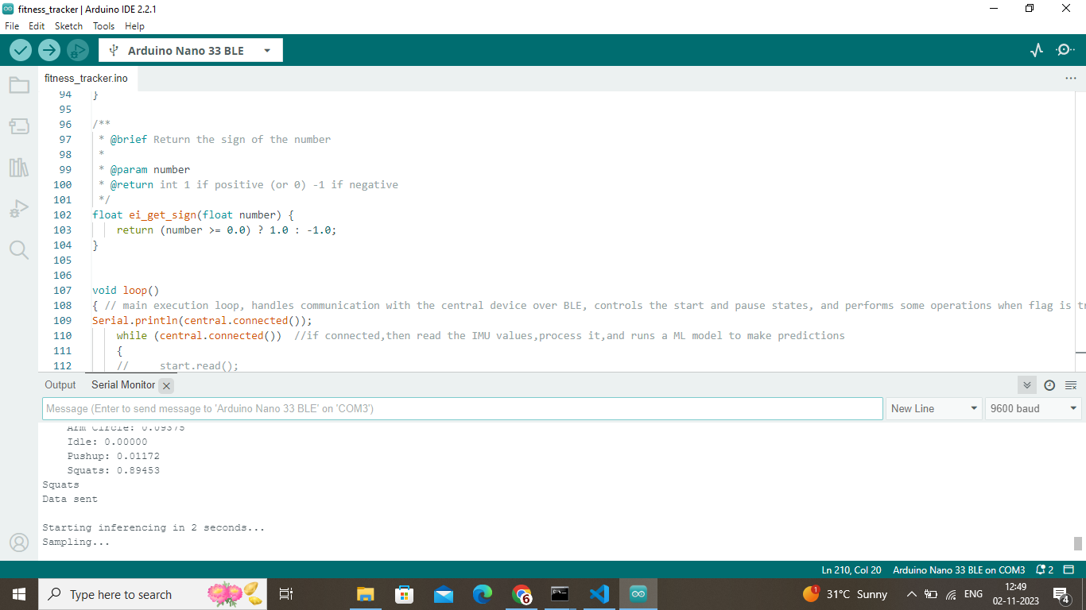

Slide 10
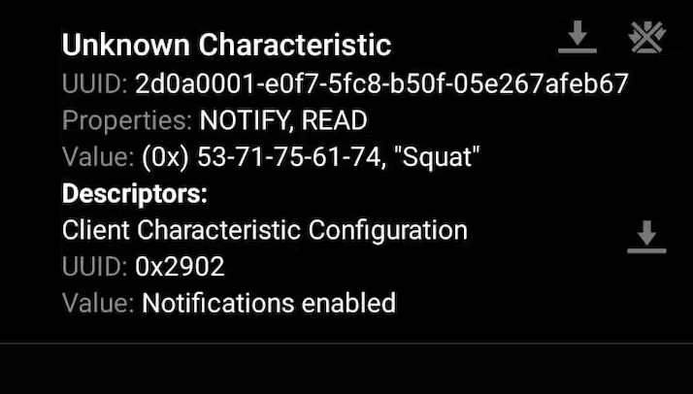
Data collection via mobile using NRF connect

Slide 11
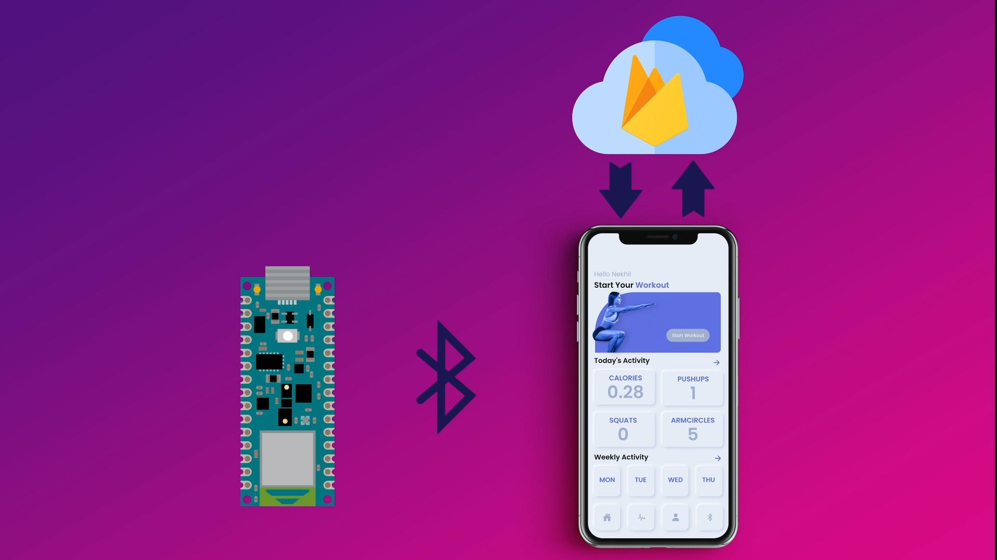

User interface and data flow

Slide 12
Firebase
A Comprehensive platform for building and managing web and mobile applications.
Features:
Cloud-based platform
Real-time Database
Hosting
Scalability

Slide 13
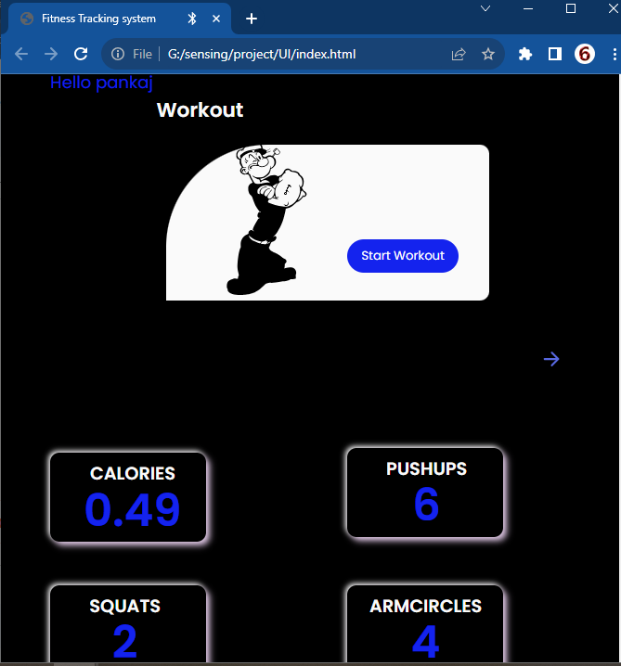
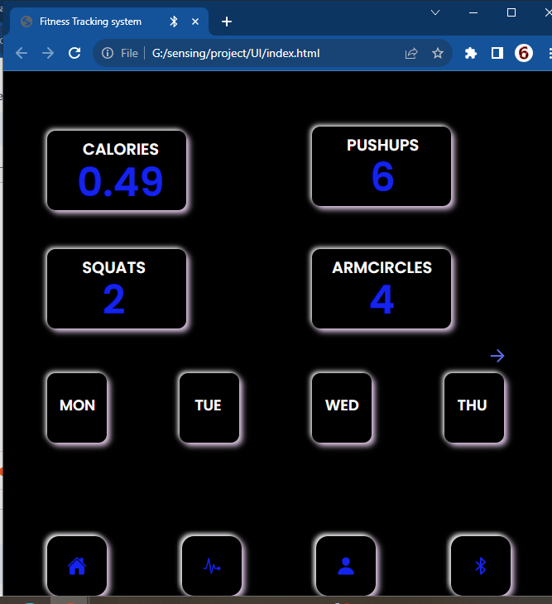
User Interface

Slide 14
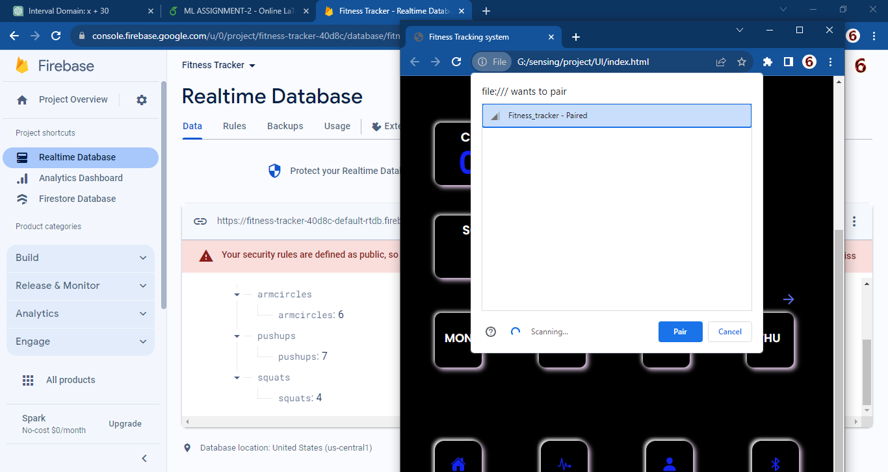

Slide 15
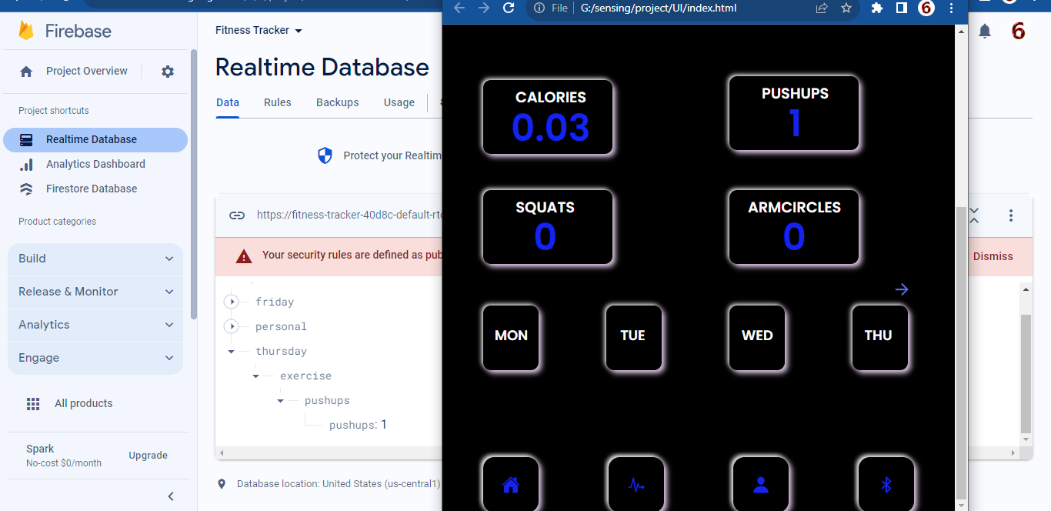

Slide 16
Calorie calculation formula-Metabolic Equivalent of Task(MET)
To estimate the calories burned during pushups using Metabolic Equivalent of Task (MET), you can use the formula:
Calories Burned=(MET×weight in kg×duration in hours)/200

Slide 17
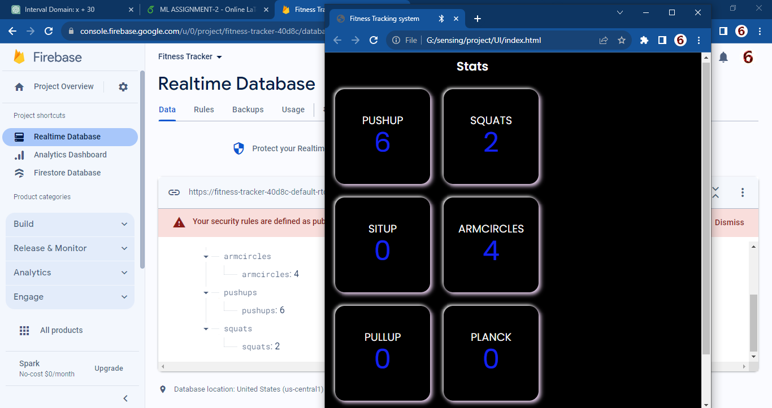

Slide 18
Thank You

